Slide 1



Web 2.0: An Introduction
http://www.ukoln.ac.uk/web-focus/events/seminars/cilip-ucrg-2006-12/
Brian Kelly
UKOLN
University of Bath
Bath
Acceptable Use Policy
Recording/broadcasting of this talk, taking photographs, discussing the content using email, instant messaging, Blogs, SMS, etc. is permitted providing distractions to others is minimised.
Email
B.Kelly@ukoln.ac.uk
Resources bookmarked using 'cilip-ucrg-2006-12' tag
UKOLN is supported by:
This work is licensed under a Attribution-NonCommercial-ShareAlike 2.0 licence (but note caveat)

Slide 2
About Me
Brian Kelly:
  UK Web Focus: a Web advisory post based at UKOLN
  Funded by JISC and MLA to advise HE/FE and cultural heritage sectors
  Web enthusiast since Jan 1993
UKOLN:
  National centre of expertise in digital information management
  Located at the University of Bath

Slide 3
Contents
Web 2.0 – What Is It?
  RSS • Mashups
  Blogs • Wikis
  Microformats • Comms tools
  Social bookmarking • …
Deployment Strategies
  User Focus
  Information literacy; staff development
  Risk assessment
  Safe experimentation

Slide 4
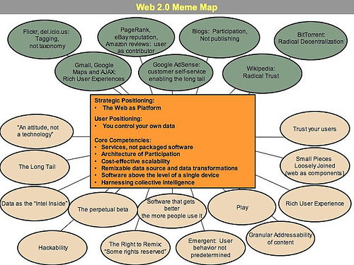
Web 2.0
Web 2.0
What Is Web 2.0?
Marketing term (derived from observing 'patterns') rather than technical standards - “an attitude not a technology”
Characteristics Of Web 2.0
  Network as platform
  Always beta
  Clean URIs
  Remix and mash-ups
    Syndication (RSS)
  Architecture of participation
    Blogs & Wikis
    Social networking
    Social tagging (folksonomies)
  Trust and openness
Web2MemeMap, Tim O’Reilly, 2005

Slide 5
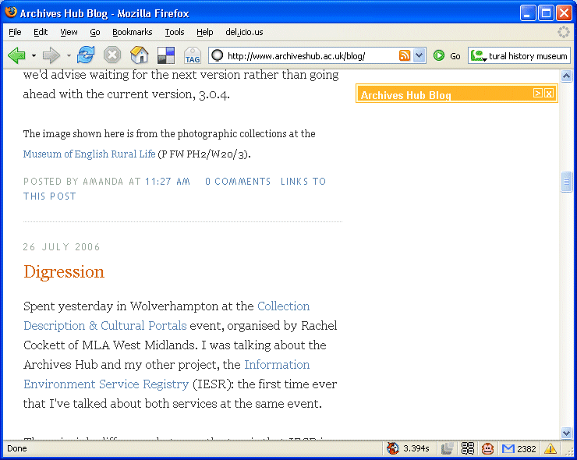
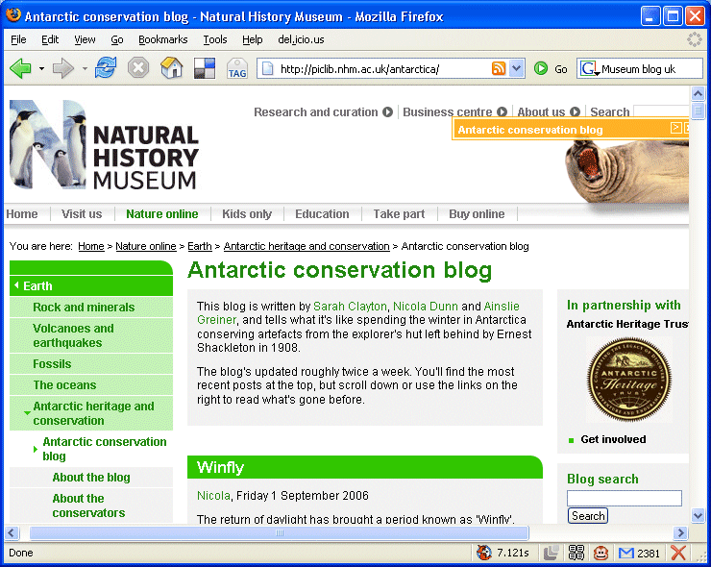
Blogs
Key Characteristics
Openness
Syndication
Collaboration
Web 2.0
http://www.archiveshub.ac.uk/blog/
http://piclib.nhm.ac.uk/antarctica/
Blogs – social phenomenon of the C21st?
Need for information professionals to:
  Understand Blogging & related technologies (e.g. RSS, Technorati)
  Be able to find resources in the 'Bloggosphere'
  Explore how to Blogs to support business functions (support users, staff & organisation)
Increasingly professional (e.g. developers) use Blogs to describe what they're doing.
Note that a Comments field can allow you to engage in discussions
This blog … tells what it's like spending the winter in Antarctica conserving artefacts from the explorer's hut left behind by Ernest Shackleton in 1908.

Slide 6
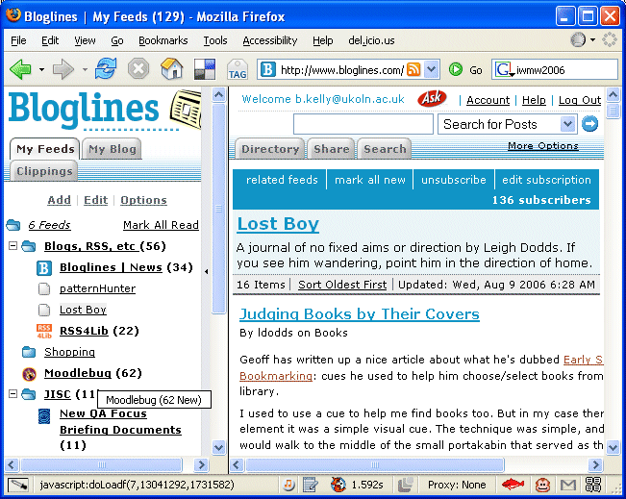
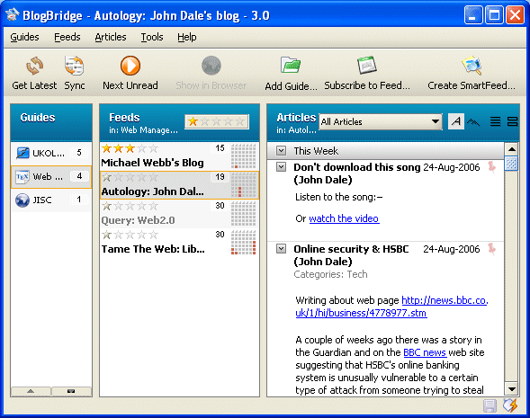
Blogs - Reading
Openness
Syndication
Collaboration
Web 2.0
How do you keep informed of developments?
  Do you use a dedicated Blog reader?
  Are you alerted of changes to key Blogs?
  Do you focus on the content, and avoid the distractions of ads, etc.
http://www.bloglines.com/myblogs
BlogBridge – a desktop Blog reader. You are informed of changes since you last viewed the page.
Bloglines – a Web-based Blog reader. You are informed of changes since you last viewed the page.

Slide 7
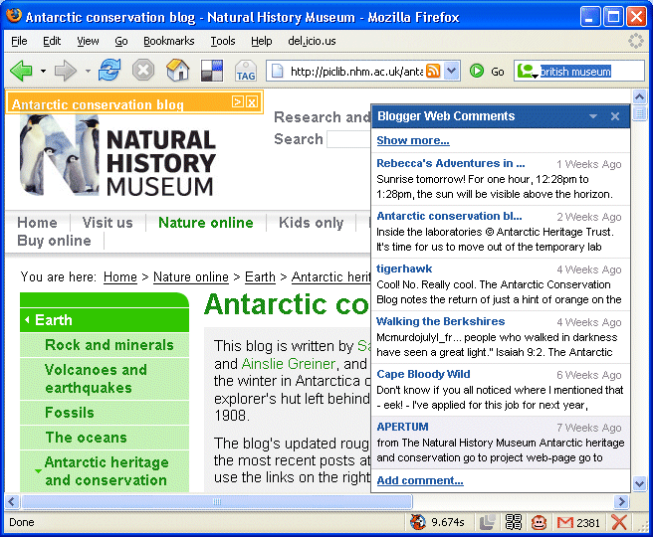
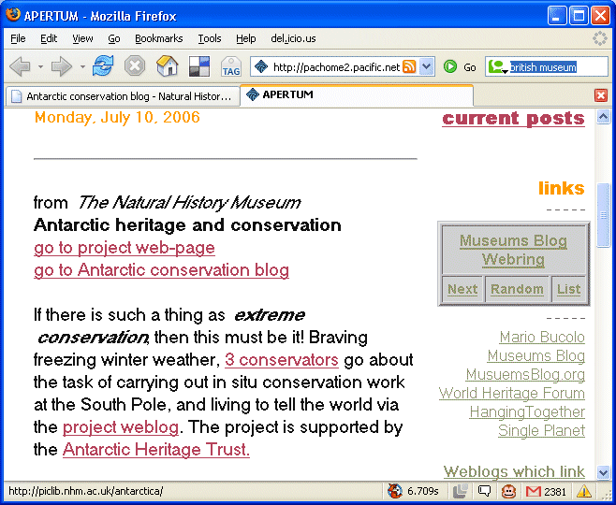
What Are They Saying About Us?
Web 2.0
http://piclib.nhm.ac.uk/antarctica/
http://pachome2.pacific.net.sg/~schizoid/para/ …
Blogs are very interconnected with each other (Bloggers discuss other Blog postings).
This can help to provide feedback; measure impact; engage in discussions; etc.
Blogger Web Comments tool lights up if Blog comments about Web site have been made. Alternatively go to the Google Blog search

Slide 8
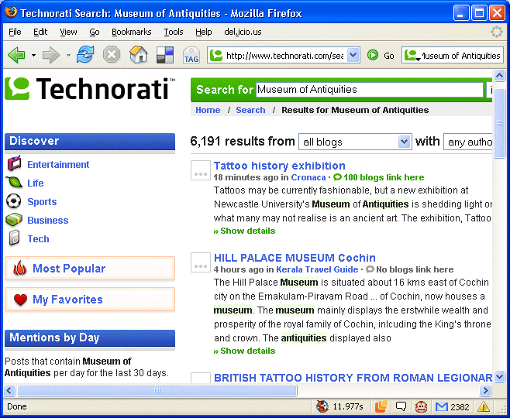
Finding Resources
RSS
Syndication
Web 2.0
http://www.technorati.com/ …
Technorati can help find Blog articles, etc.
Technorati search for "Museum of Antiquities" finds:
  Blog posting about current exhibition posted 11 minutes ago!
Google search finds:
  Museum home page
What do users want: the home page and what people are saying today. Google & Technorati are valuable tools, so organisations should ensure that their Web site can be found in both.

Slide 9
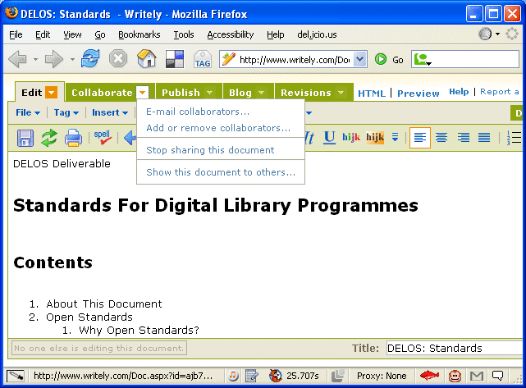
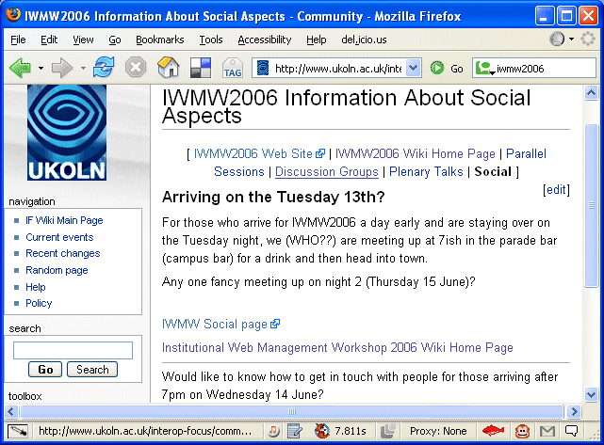
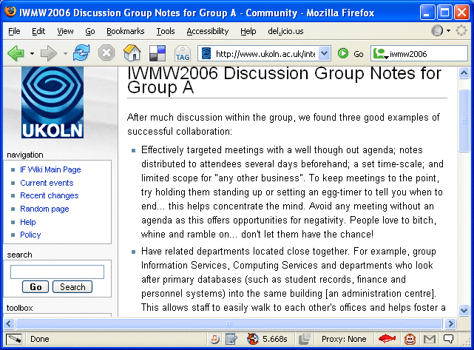
Wikis
Openness
Syndication
Collaboration
Web 2.0
http://www.ukoln.ac.uk/interop-focus/community/index/
IWMW2006_Information_About_Social_Aspects
Wikis – collaborative Web-based authoring tools
I use Wikis for:
  Collaborative papers (avoiding emailed MS Word file around)
http://www.ukoln.ac.uk/interop-focus/community/index/
IWMW2006_Discussion_Group_Notes_for_Group_A
http://www.writely.com/
  Note-taking at events
  Social discussions at events
Writely – Web-based word processor or Wiki? Does it matter, it does the job
Remember when notes were trapped in the non-interoperable world of flip charts & paper. This need no longer be the case.

Slide 10
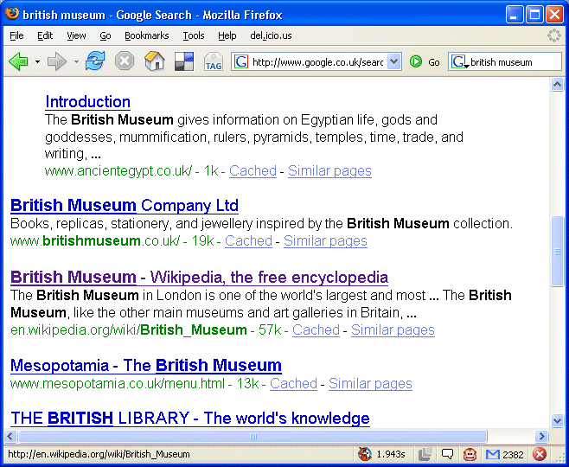
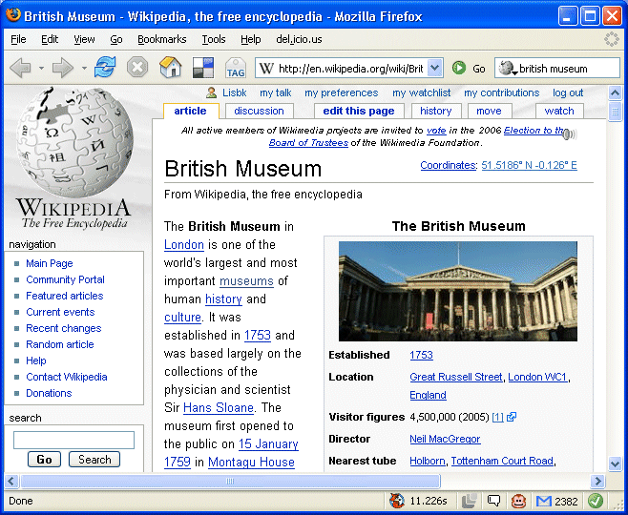
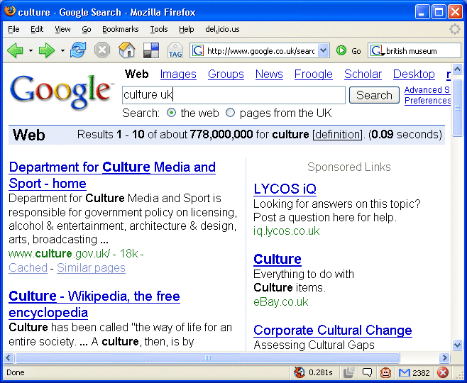
Wikipedia
http://www.google.co.uk/search?q=culture
http://www.google.co.uk/search
?q=british+museum
http://en.wikipedia.org/wiki/British_Museum
Wikipedia – not only a community-developed encyclopedia, but also a well-linked Web site, which boosts Google rankings
In top 10 in Google list
Do you try and ensure your Web site is easily found when searching? If so, then an entry in Wikipedia could help with this business objective

Slide 11
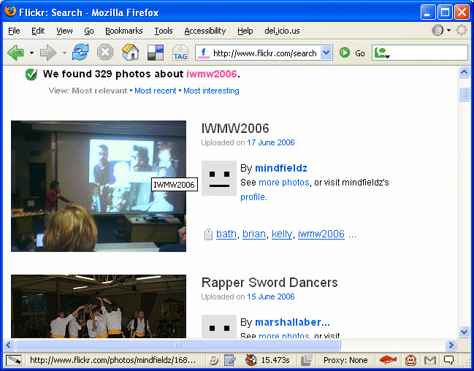
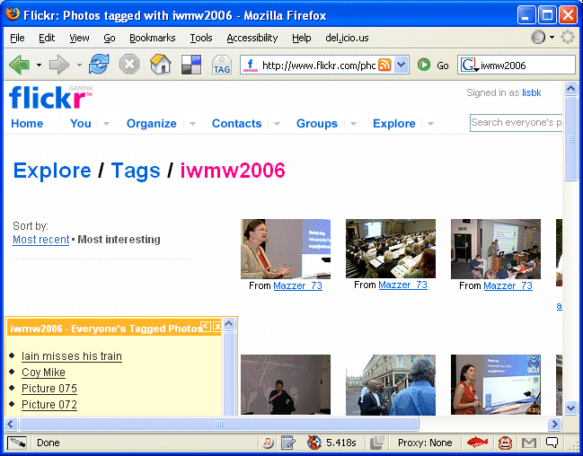
Sharing - Flickr
Openness
Network effect
Syndication
Collaboration
Web 2.0
http://www.flickr.com/search/
?w=all&q=iwmw2006&m=text
Web 2.0 includes community-building
You can help support your community-building by making it easy to share photos at events (e.g. this seminar)
Simply suggest a tag e.g. ‘cilip-ucrg-2006-12-01’ and encourage delegates to upload their photos with this tag
http://www.flickr.com/photos/tags/
iwmw2006/interesting/?page=6

Slide 12
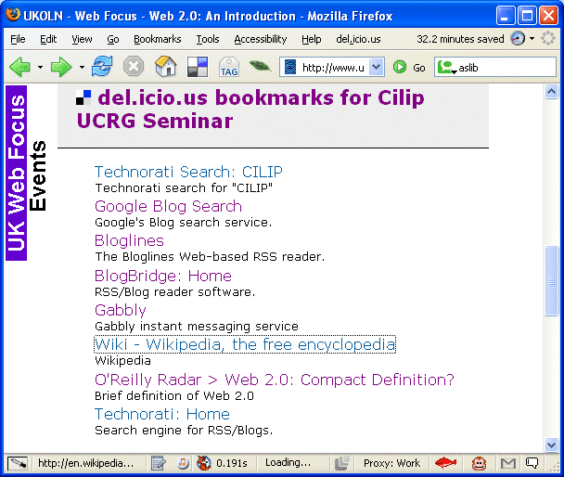
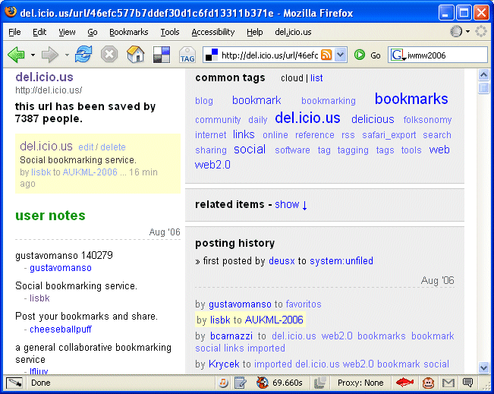
Sharing – del.icio.us
Openness
Network effect
Syndication
Collaboration
Web 2.0
http://del.icio.us/lisbk/cilip-ucrg-2006-12
Another aspect of sharing is sharing bookmarks
This can be used to:
  Manage your bookmarks
  Allow others to contribute resources
  Allow lists of bookmarks to be repurposed
  Carry out impact analysis
Who else has bookmarked this resources? What are their interests?
(I may have similar interests) How many have bookmarked my resource?

Slide 13
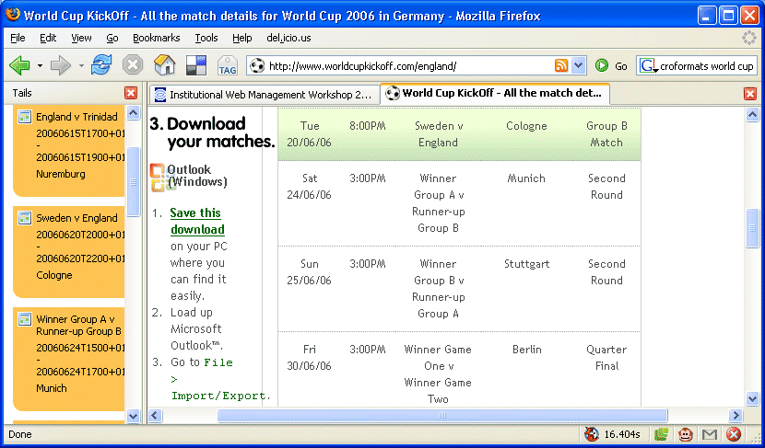
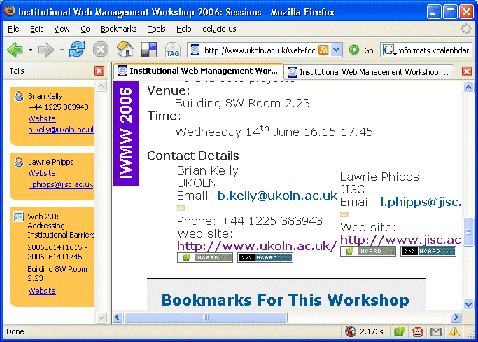
Microformats
Tags
Collaboration
Web 2.0
http://www.worldcupkickoff.com/england/
http://www.ukoln.ac.uk/web-focus/events/
workshops/webmaster-2006/sessions/kelly
Add simple semantics using <span>, <div>, etc. classes:
Pages on IWMW 2006 Web site have microformats
Plugins such as Tails display contact and event details & allow them to be uploaded to Outlook, Google Calendar, etc
World Cup Web site also has microformats. This avoids the cumbersome downloading dates, entering calendar, selecting import, finding file, …

Slide 14
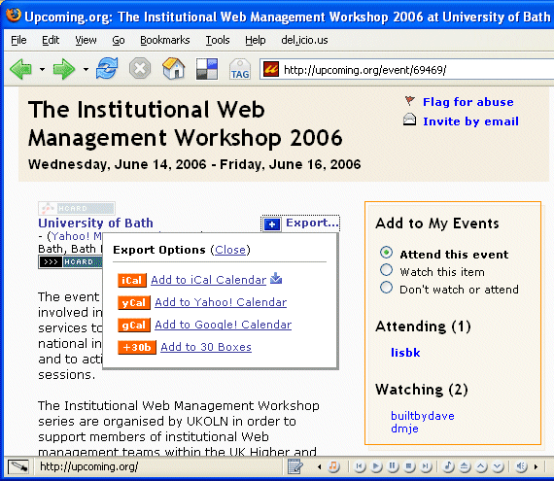
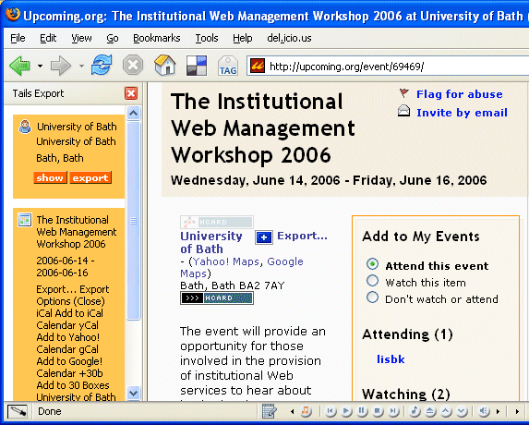
Web As A Platform
Network
Users
Tags
Collaboration
Web 2.0
http://upcoming.org/event/69469/
Upcoming.org can deliver traffic to your Web site, who may then book for the event
They provide
  Event details
  Microformats (event, location)
  Exporting functionality
  Community space
Other people can take my data and use it to provide my event. They also provide additional functionality for me ☺

Slide 15
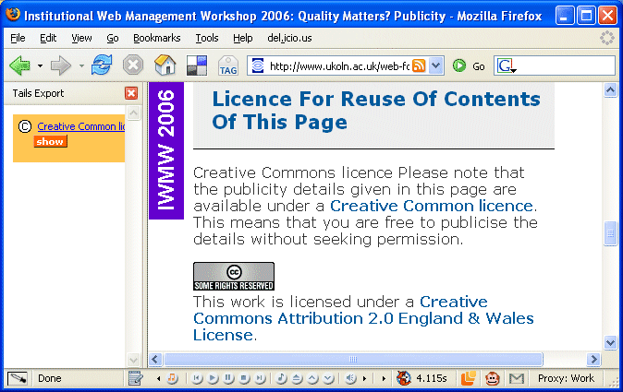
Creative Commons
Openness
Tags
Collaboration
Web 2.0
http://www.ukoln.ac.uk/web-focus/events/
workshops/webmaster-2006/publicity/
Hasn’t Upcoming.com contributor infringed my copyright (even though it’s to my benefit?)
  Creative Commons licence assigned to publicity details
  Also described in microformat to allow software to find licence
Note that the openness is a key aspect of Web 2.0: open source; open standards and open content can all help to bring benefits through maximising usage of services

Slide 16
Mapping Services & The Web
Web 2.0
Web 2.0 provides valuable opportunity to provide mapping & location services:
  Embedding Google maps on your Web sites
  Developing rich services using this
  Providing location metadata / microformats which can be processed by simple browser tools

Slide 17
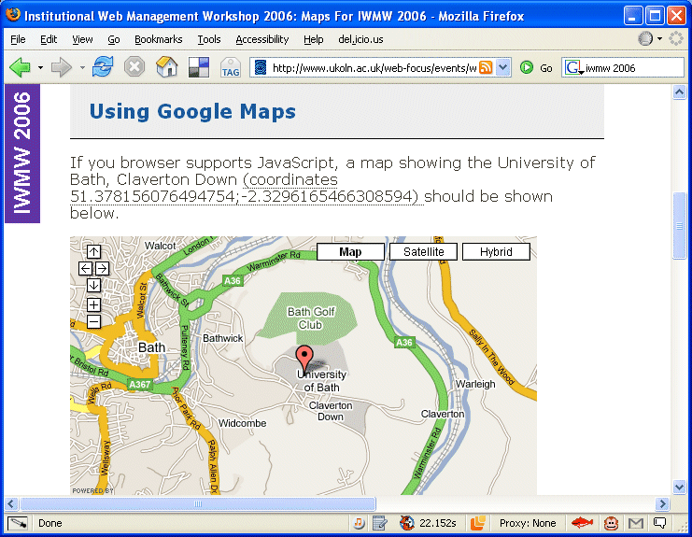
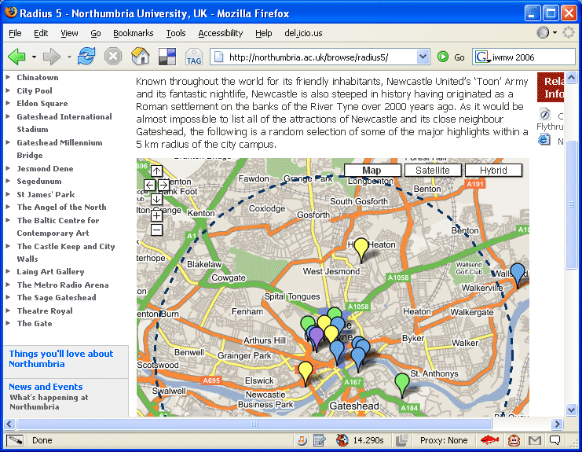
Google Maps Mashups
Openness
Mashup
APIs
Web 2.0
http://northumbria.ac.uk/browse/radius5/
http://www.ukoln.ac.uk/web-focus/events/
workshops/webmaster-2006/maps/
Google Map ‘mashup’ used for IWMW 2006 event:
  ~ 20 lines of JavaScript.
  Code taken from Googler Maps Web site and coordinates added
More sophisticated mapping applications are being developed, such as Radius 5 at Northumbria Univ.

Slide 18
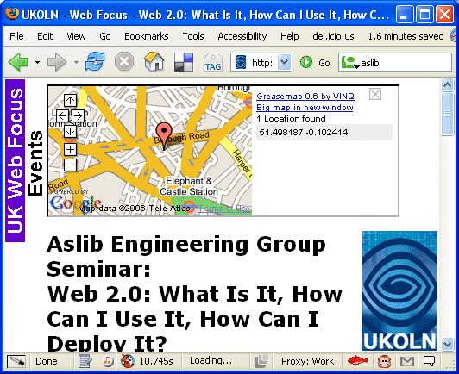
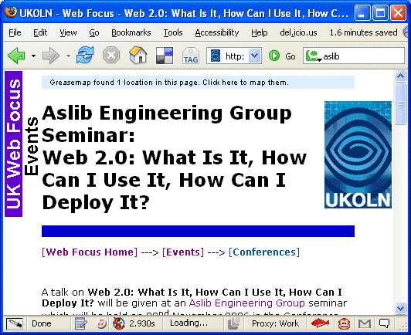
Location Metadata (1)
Openness
Mashup
Open source
APIs
Web 2.0
http://www.ukoln.ac.uk/web-focus/events/
seminars/aslib-2006-11/
Embedded location metadata can now by exploited by 3rd party tools
Why don't all our organisation provide location data in this way?
Note issues about quality of data & responsibilities for providing the data (e.g is this the right address?)
How? Install Greasemap script & add:
<meta name="geo.position" content=" 51.498187, -0.102414 " />
<meta name="geo.placename" content=“LSBU" />

Slide 19
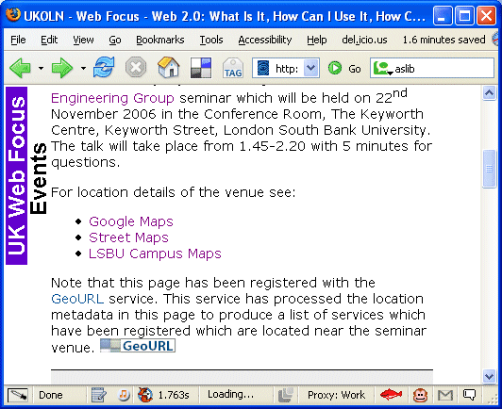
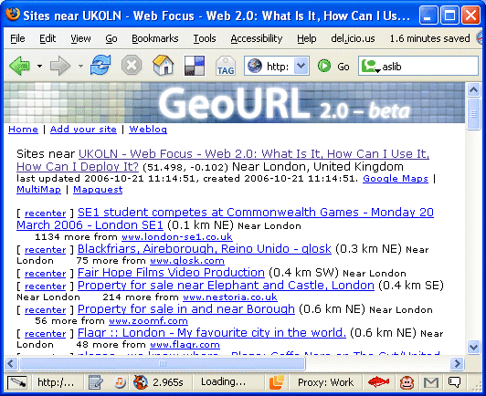
Location Metadata (2)
Openness
Sharing
Open standards
Always beta
Web 2.0
http://geourl.org/near?p=http://www.ukoln.ac.uk/web-focus/events/seminars/aslib-2006-11/
Same location metadata can be used by other applications
In this example the GeoURL service gives details of registered services which are located close to this venue
Note that the software described is not the important feature – it's the data and the use of open standards that's important. New software and services will come and go (remember 'always beta')

Slide 20
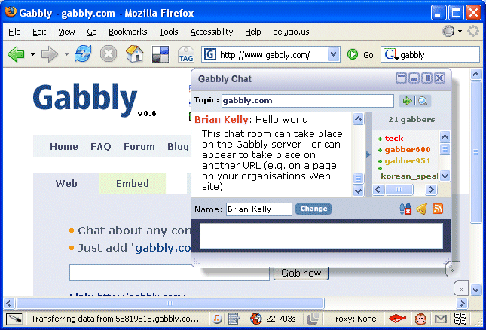
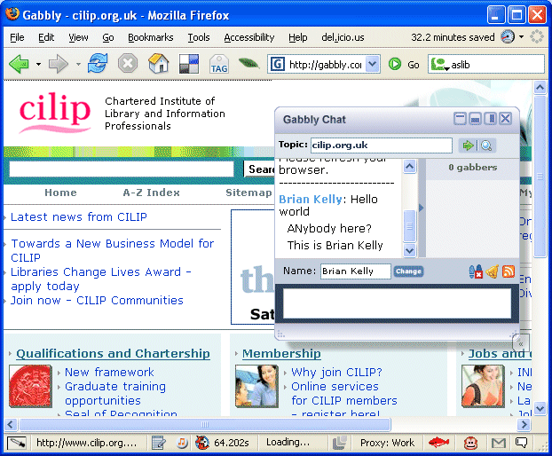
Communications
Communications
Clean URIs
Web 2.0
http://www.gabbly.com/
Realtime discussion is a key part of the Web 2.0 and the .net generation (IM, SMS messaging, …)
How much effort does it take to provide an instant messaging service for your organisation?
Try Gabbly.com
Note:
  Most effective with ‘clean URIs’
  Data an be exported using RSS
  User support? What user support?

Slide 21
Web 2.0 Backlash
When significant new things appear:
  Enthusiasts / early adopters predict a transformation of society
  Sceptics outline the limitations & deficiencies
There’s a need to:
  Promote the benefits to the wider community (esp. those willing to try if convinced of benefits)
  Be realistic and recognise limitations
  Address inappropriate criticisms
Deployment Challenges
Web 2.0: It’s a silly name. It’s just a marketing term. There are lots of poor Web 2.0 services. There wasn’t a Web 1.0. What follows it?
It does have a marketing aspect – and that’s OK. It isn’t formally defined – it describes a pattern of related usage. There will be poor (and good) Web 2.0 services – just like anything else. Any usage will arrive at a follow-up term.

Slide 22
Takeup Of New Technologies
The Gartner curve
Rising expectations
Service plateau
Enterprise software
Large budgets
…
Chasm
Failure to go beyond developers & early adopters (cf Gopher)
Need for:
  Advocacy
  Listening to users
  Addressing concerns
  Deployment strategies
  …
Trough
of despair
Developers
Early
adopters
This talks looks at approaches for avoiding the chasm

Slide 23
Beware The IT Fundamentalists
We need to avoid simplistic solutions to the complexities:
  Open Standards Fundamentalist: we just need XML
  Open Source Fundamentalist: we just need Linux
  Vendor Fundamentalist: we must use next version of our enterprise system (and you must fit in with this)
  Accessibility Fundamentalist: we must do WAI WCAG
  User Fundamentalist: must do whatever users want
  Legal Fundamentalist: it breaches copyright, …
  Ownership Fundamentalist: must own everything we use
  Perfectionist: It doesn't do everything, so we'll do nothing
  Simplistic Developer: I've developed a perfect solution – I don't care if it doesn't run in the real world
  Web 2.0: It’s new; its cool!
IT Services Barrier

Slide 24
The Librarian Fundamentalists
Library Barrier
Librarians:
  Think they know better than the user e.g. they don't like people using Google Scholar; they should use Web of Knowledge (who cares that users find it easier to use Google Scholar & finds references they need that way?)
  Think that users should be forced to learn Boolean searching & other formal search techniques because this is good for them (despite Sheffield's study).
  Don't want the users to search for themselves (cf folksonomies) because they won't get it right.
  They still want to classify the entire Web - despite the fact that users don't use their lists of Web links.
  Want services to be perfect before they release them to users. They are uneasy with the concept of 'forever beta' (they don't believe that users have the ability to figure things out themselves and work around the bugs).

Slide 25
Deployment Strategies
Interested in using Web 2.0 in your organisation?
Worried about corporate inertia, power struggles, etc?
There’s a need for a deployment strategy:
  Addressing business needs
  Low-hanging fruits
  Encouraging the enthusiasts
  Gain experience of the browser tools – and see what you’re missing!
  Staff training & development
  Address areas you feel comfortable with
  Risk management strategy
  …
Deployment Challenges

Slide 26
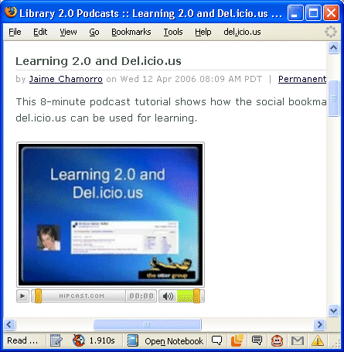
Staff Development
http://podcasts.alablog.org/blog/
_archives/2006/4/12/1881517.html
There's a need for your staff to:
  Understand what Web 2.0 is about
  Learn how to make use of Web 2.0
subject to constraints of lack of time; resources; etc.
The Library 2.0 Podcasts
Web sites provides a useful resources for learning about new tools, techniques, etc.
Deployment Challenges

Slide 27
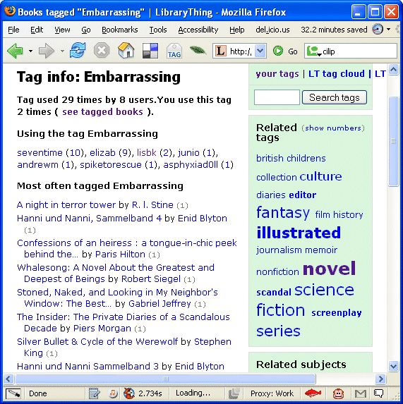
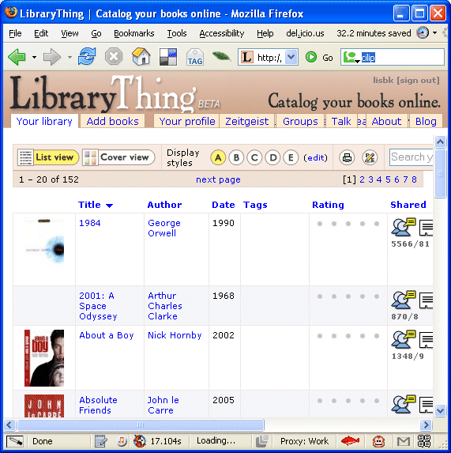
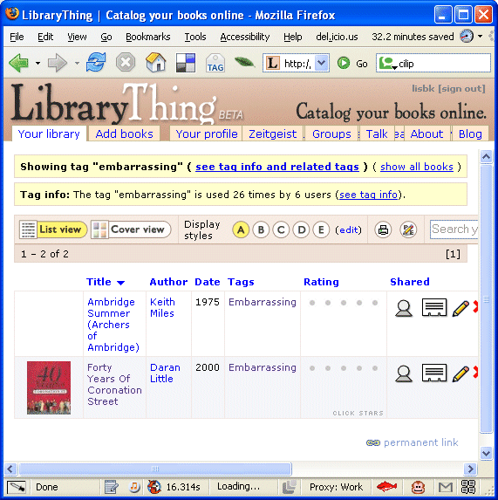
Information Literacy
http://www.librarything.com/
tag/Embarrassing
Librarything provides a good example of a Web 2.0 service:
  Catalogue your books
  AJAX interface
  Exploit data provided by the community
  Export capabilities
  Other books you may like
  …
Service may have potential to support information literacy. Not only understanding the service, but also to illustrate possible dangers of creating embarrassing content ☺

Slide 28
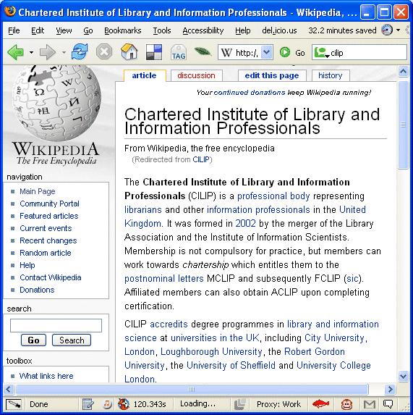
Wikipedia
Opportunities
http://en.wikipedia.org/wiki/CILIP
Wikipedia entry for CILIP:
  Easy to create
  Provides high-profile information (Google-friendly)
  Allows community to enhance & develop content
  Created in 2004
You’ve an entry in Wikipedia ☺
But do you have a video clip in YouTubes?

Slide 29
IWMW 2006 & Risk Management
IWMW 2006 has taken a risk management approach to its evaluation of Web 2.0 technologies:
  Agreements: e.g. in the case of the Chatbot.
  Use of well-established services: Google & del.icio.us are well-established and have financial security.
  Notification: warnings that services could be lost.
  Engagement: with the user community: users actively engage in the evaluation of the services.
  Provision of alternative services: multiple OMPL tools.
  Use in non-mission critical areas: not for bookings!
  Long term experiences of services: usage stats
  Availability of alternative sources of data: e.g. standard Web server log files.
  Data export and aggregation: RSS feeds, aggregated in Suprglu, OPML viewers, etc.
Deployment Strategy

Slide 30
Conclusions
Conclusions
To conclude:
  Web 2.0 can provide real benefits for our users
  However organisations tend to be conservative
  We therefore need:
    Advocacy
    To listen to users' concerns
    To address users' concerns e.g. risk management
  We can all benefit by adopting Web 2.0 principles of openness and sharing. So let us:
    Share our advocacy resources, risk management techniques, etc.
    Develop your own social network based on openness, trust, collaboration, ..
  Read my UKWebFocus.wordpress.com Blog

